Slide 1




SMART INDIA HACKATHON 2026
  Problem Statement ID – 26124
  Problem Statement Title – AI-Powered Mobile Urban
  Intelligence Platform Using public Transport Fleet.
  Theme – Smart Automation
  PS Category – Software
  Team Name – Void Matrix

Slide 2

The Problem Statement
Cities Are Flying Blind
Today's urban infrastructure monitoring relies on fixed CCTV, manual inspections, and citizen complaints, a fragmented, reactive system that leaves cities perpetually behind the curve.
Delayed Response
Road defects, congestion, and unsafe behavior go undetected until they cause accidents or costly damage.
Wasted Assets
Bus fleets traverse every major road daily with multi-camera systems, yet cameras only record incidents instead of actively sensing infrastructure.
Incomplete Awareness
No single platform aggregates road condition, traffic, and safety data into a unified city intelligence layer.

Slide 3
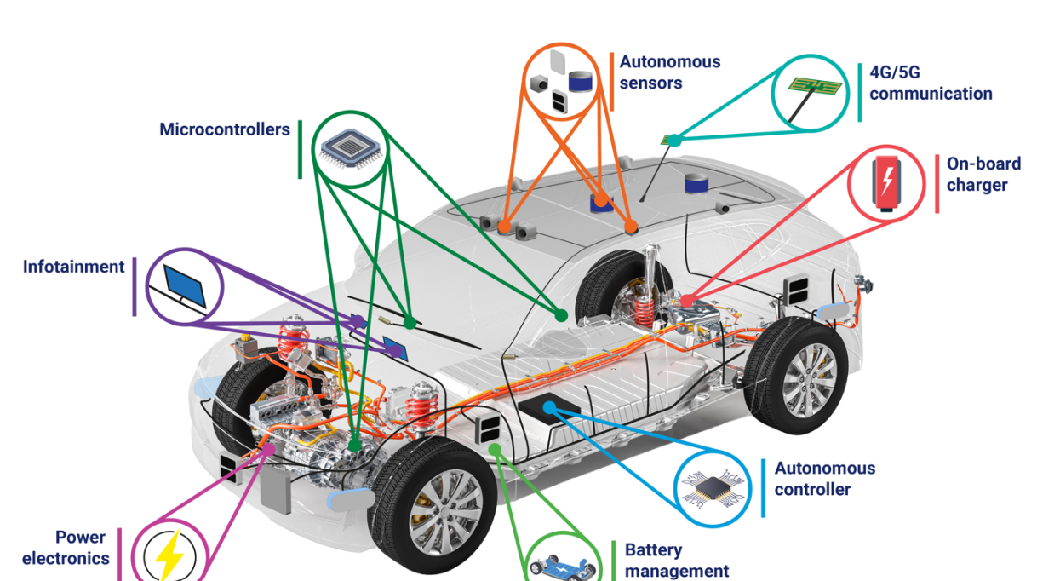


The Solution: Buses as Mobile Sensors
Every bus becomes an intelligent node, continuously sensing,
analyzing, and reporting on the city around it.
Edge AI Onboard
Real-time video analysis detects potholes, cracks, waterlogging, missing infrastructure, and vulnerable pedestrian situations, processed directly on the bus.
Vehicle Intelligence
Detects rash driving and hit-and-run incidents, extracts license plates with GPS coordinates and timestamps for law enforcement integration.
Centralized Platform
Fleet data aggregated into GIS dashboards, congestion heatmaps, and actionable maintenance alerts for city operators.

Slide 4
Revenue Streams, ROI, Market Traction & Deployment
SaaS Licensing
Target Markets
Maintenance Savings
We are targeting mid-size cities with 500–2,000 bus fleets across Asia, Africa, and Latin America, markets with high infrastructure needs, government smart city mandates, and lower competitive density than mature Western markets.
Per-bus subscription model at
₹1000/Month–₹10K/bus/year scales linearly with fleet size, predictable ARR from day one.
Proactive road repair scheduling reduces emergency infrastructure costs by 40–60% for city clients.
Traffic Optimization
Go-to-Market Approach
Safety & Compliance
Municipal transport authority partnerships provide fleet access, data rights, and government co-investment, reducing customer acquisition cost and accelerating regulatory approval.
Congestion intelligence improves route efficiency and reduces municipal fuel costs by 15–25%.
Hit-and-run detection and incident evidence reduce city liability exposure and unlock insurance cost reductions.
YOLOv8 fusion achieving 93.3% recall and 94.53% F1 score — a 6.5% improvement over standalone methods

Slide 5
SDG 11 Alignment: Sustainable Cities
Built for UN Sustainable Development Goal 11
Our platform directly advances SDG 11 targets, making cities inclusive, safe, resilient, and sustainable through technology that already exists in every bus fleet.
Safe Transport
Infrastructure Resilience
Inclusive Mobility
Detects unsafe driving and pedestrian hazards in real time, directly advancing SDG 11.2's mandate to improve road safety and access to safe transport for all by 2030.
Proactive maintenance extends road life and reduces emergency repair costs, building the durable urban infrastructure SDG 11 demands.
Improved traffic flow and safety raise public transport reliability for elderly, disabled, and low-income populations.

Slide 6
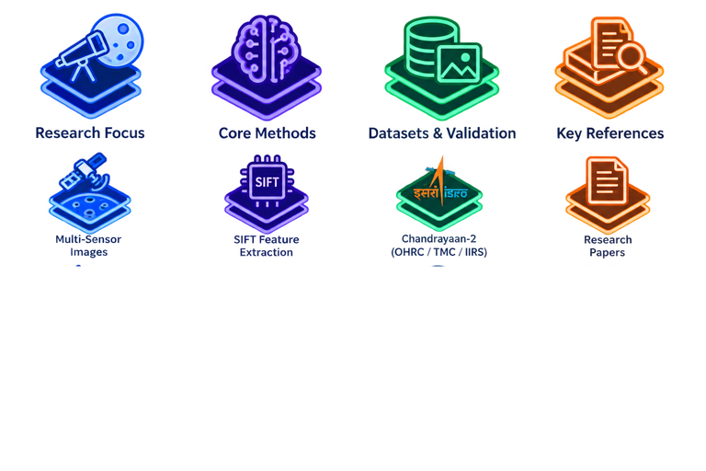
Research Work & References
Research Focus
Datasets & Validation
Real-time urban edge-sensing via public bus fleets for road and safety audits
Tested on RDD2022; achieves 95.8% precision, 93.3% recall, and 27ms latency.
Core Methods
Key References
Lightweight YOLOv8 (GhostConv/attention), ByteTRACK, ANPR, and GPS-GIS telemetry sync.
Arya et al. (RDD2022 Dataset), Zeng & Zhong (YOLOv8 Road Detection), Zheng et al. (Urban Computing)

